Slide 1
Caches-Classroom-Slides

Slide 2
B
U
F
F
E
R
B
U
F
F
E
R
B
U
F
F
E
R
B
U
F
F
E
R
IF
ID/RR
EX
MEM
WB
Instruction
in
Instruction
out

Slide 3
CPU
Cache
Main memory

Slide 4
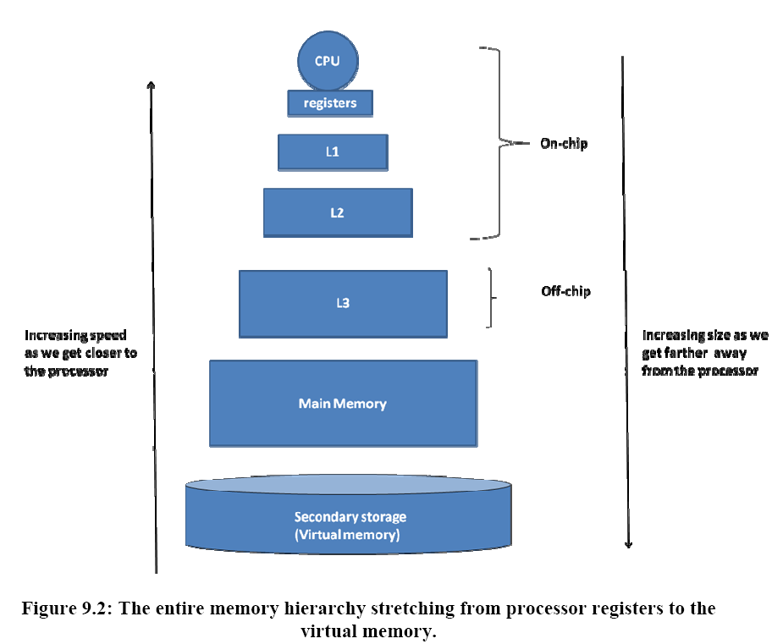

Slide 5
CPU
L1- cache
h₁ = 0.95; T_{h1} = 2 ns
L2- cache
h₂ = 0.80; T_{h2} = 10 ns
T_{m} = 100 ns
Main memory
EMAT?

Slide 6
Direct mapped cache
0
1
2
3
0
4
1
5
2
6
3
7
4
8
5
9
6
10
7
11
12
13
14
Given a memory address,
What is the numerical value of cache index?
15

Slide 7
Memory reference: 0, 1, 2, 3, 1, 3, 0, 8, 0, 9, 10
0
mem loc 0
1
mem loc 1
2
mem loc 2
3
mem loc 3
4
empty
5
empty
6
empty
7
empty

Slide 8
Memory reference: 0, 1, 2, 3, 1, 3, 0, 8, 0, 9, 10
0
mem loc 0 8
1
mem loc 1
2
mem loc 2
3
mem loc 3
4
empty
5
empty
6
empty
7
empty

Slide 9
Memory reference: 0, 1, 2, 3, 1, 3, 0, 8, 0, 9, 10
0
mem loc 0 8 0
1
mem loc 1
2
mem loc 2
3
mem loc 3
4
empty
5
empty
6
empty
7
empty

Slide 10
How do we disambiguate?
tag
data
0
1
mem loc 0 8
1
0
mem loc 1
2
0
mem loc 2
3
0
mem loc 3
4
empty
5
empty
6
empty
7
empty

Slide 11
How do we know it is valid?
valid
tag
data
0
1
loc 8
1
1
1
loc 1
0
2
1
loc 2
0
3
1
loc 3
0
4
empty
0
X
5
0
empty
X
6
X
0
empty
7
0
empty
X
Valid
Tag
data

Slide 12
Interpreting memory address
Cache Tag
Cache Index
Why not the other way around?

Slide 13
valid
tag
data
valid
tag
data
valid
tag
data
valid
tag
data
1
loc 0
0
1
1
0
1
0
0
loc 0 1
0
1
loc 0 1 0
0
1
loc 0 1 0 1
1
0
empty
1
0
empty
1
0
empty
1
0
empty
X
X
X
X
2
0
empty
2
0
empty
2
0
empty
2
0
empty
X
X
X
X
3
0
empty
3
0
empty
3
0
empty
3
0
empty
X
X
X
X
4
empty
empty
empty
empty
0
X
4
0
X
4
0
X
4
0
X
5
0
empty
5
empty
5
empty
5
empty
X
0
X
0
X
0
X
X
X
X
X
6
0
empty
6
0
empty
6
0
empty
6
0
empty
7
0
empty
7
empty
7
empty
7
empty
X
0
X
0
X
0
X
Access location 0
Access location 1
Access location 0
Access location 1
Cache occupancy if we switch index and tag
BAD!!

Slide 14
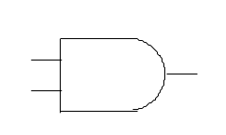
Hardware
Cache
Tag
Valid
Tag
data
Cache Index
.
.
.
.
.
.
Data
To
CPU
=
hit

Slide 15
Example
Let us consider the design of a direct-mapped cache for a realistic memory system.
  Assume that the CPU generates a 32-bit byte-addressable memory address.
  Each memory word contains 4 bytes.
  A memory access brings in a full word into the cache.
  The direct-mapped cache is 64K Bytes in size (this is the amount of data that can be stored in the cache), with each cache entry containing one word of data.
  Compute the additional storage space needed for the valid bits and the tag fields of the cache.

Slide 16
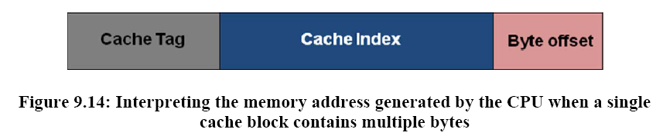
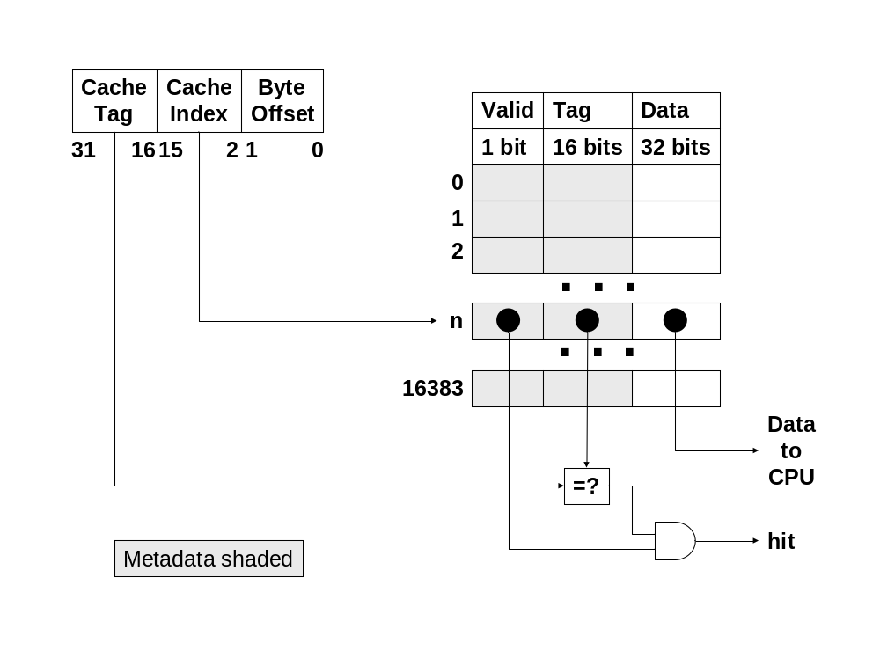

Slide 17
Pipelined processor with caches
IF
ID/RR
EXEC
MEM
WB
B
U
F
F
E
R
B
U
F
F
E
R
B
U
F
F
E
R
B
U
F
F
E
R
PC
DPRF
ALU-1
D-Cache
data
I-Cache
A
B
ALU-2
Decode
logic
DPRF
ALU

Slide 18
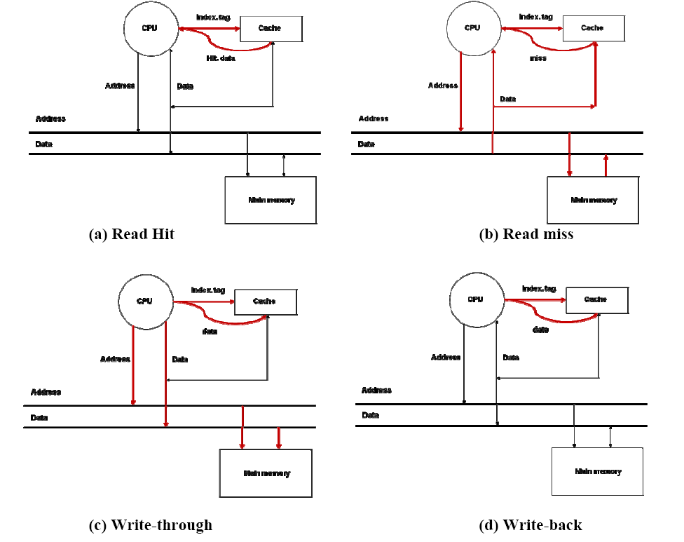

Slide 19
Write operation
CPU
Address
Data
Address
Data
Address
Data
Write Buffer
Address
Data
Address
Data
Address
Data
Main memory

Slide 20
Write back cache
Cache
Tag
Valid
Dirty
Tag
data
Cache Index
.
.
.
.
.
.
.
.
Data
To
CPU
=
hit

Slide 21
Read miss stalls
I1: ld r1,a; r1 <- memory at a
I2: add r3,r4,r5; r3 <- r4 + r5
I3: and r6,r7,r8; r6 <- r7 & r8
I4: add r2,r4,r5; r2 <- r4 + r5
I5: add r2,r1,r2; r2 <- r1 + r2

Slide 22
Execution time with caches
Execution time = N * CPI_{Avg} * cycle time
Execution time = N * CPI_{eff} * cycle time
CPI_{eff} = CPI_{Avg} + Memory-stalls_{Avg}
Execution time = N * (CPI_{Avg} + M-stalls_{Avg}) * cycle time
Memory-stalls_{Avg} = misses per instruction_{Avg} * miss-penalty_{Avg}
Total memory stalls = N * Memory-stalls_{Avg}

Slide 23
Example
Consider a pipelined processor that has an average CPI of 1.8 without accounting for memory stalls. I-Cache has a hit rate of 95% and the D-Cache has a hit rate of 98%. Assume that memory reference instructions account for 30% of all the instructions executed. Out of these 80% are loads and 20% are stores. On average, the read-miss penalty is 20 cycles and the write-miss penalty is 5 cycles. Compute the effective CPI of the processor accounting for the memory stalls.

Slide 24
Spatial Locality
Word 0
0x00
Block 0
Word 1
Word 2
Word 3
Word 0
0x04
Block 1
Word 1
Word 2
Word 3
Word 0
0x08
Block 2
Word 1
Word 2
Word 3
Word 0
0x0C
Block 3
Word 1
Word 2
Word 3
.
.
.

Slide 25
Interpreting memory address
Cache Tag
Cache Index
Block Offset
t n b
S – Size of cache; B – Block size; L – lines in cache
b = log₂B
L = S/B
n = log₂L
t = a – (b+n)

Slide 26
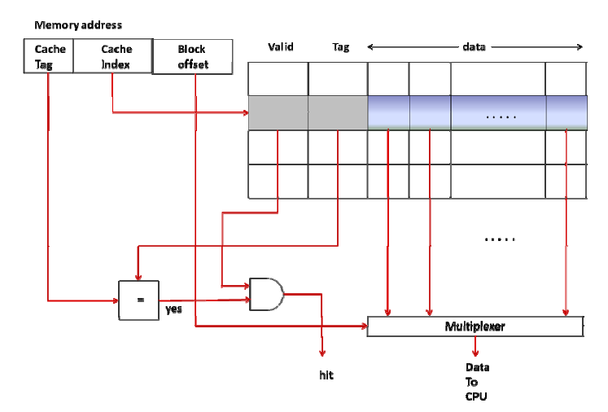
Multi-word cache Organization

Slide 27
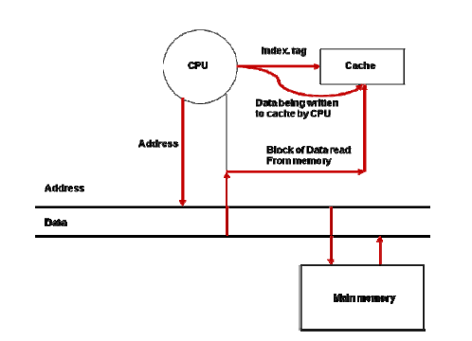
Write miss with multiple word

Slide 28
Example
Direct-mapped cache
  32-bit byte-addressable memory address.
  Each memory word contains 4 bytes.
  Block size = 4 words
  A memory access brings in a block
  64K Byte cache.
  Write back cache with a dirty bit per word

Slide 29
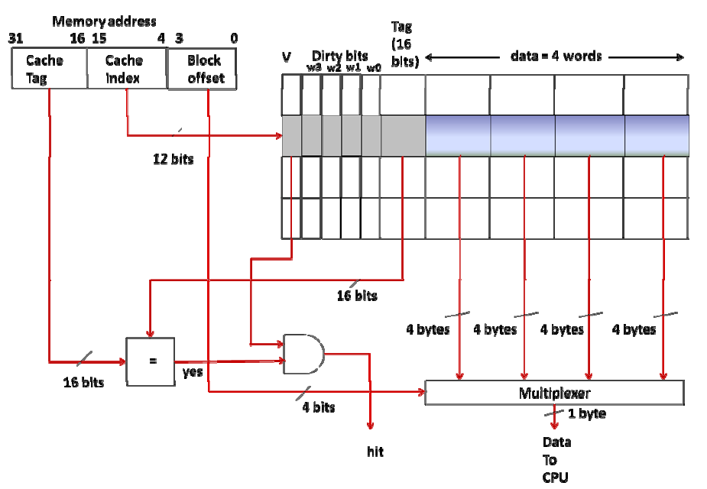

Slide 30
Miss rate
Increasing
total size
of cache
blocksize

Slide 31
Working set considerations
WS 1
WS 2
Unused
Cache
WS 3
Memory

Slide 32
Address interpretation in FA cache
Cache Tag
Block Offset

Slide 33
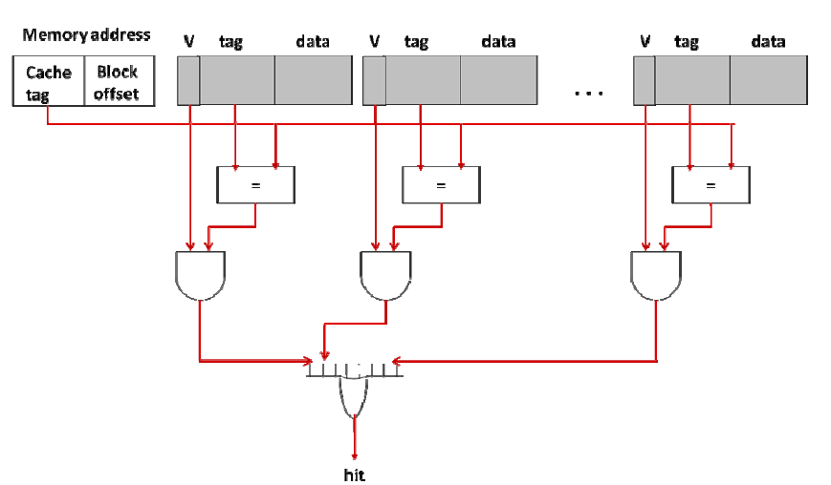

Slide 34
V
Tag
data
V
Tag
data
V
Tag
data
0
0
1
1
2
2
3
3
4
4
5
5
6
6
7
7
8
9
(b) 2-way set associative
10
11
12
13
(a) Direct-mapped cache
14
15
V
Tag
data
V
Tag
data
V
Tag
data
V
Tag
data
0
1
2
3
(c) 4-way set associative

Slide 35
Unfortunate but…
  Four different ways of saying the same thing
    Cache line
    Cache block
    Cache entry
    Set
  All mean the same thing…one row of the cache

Slide 36
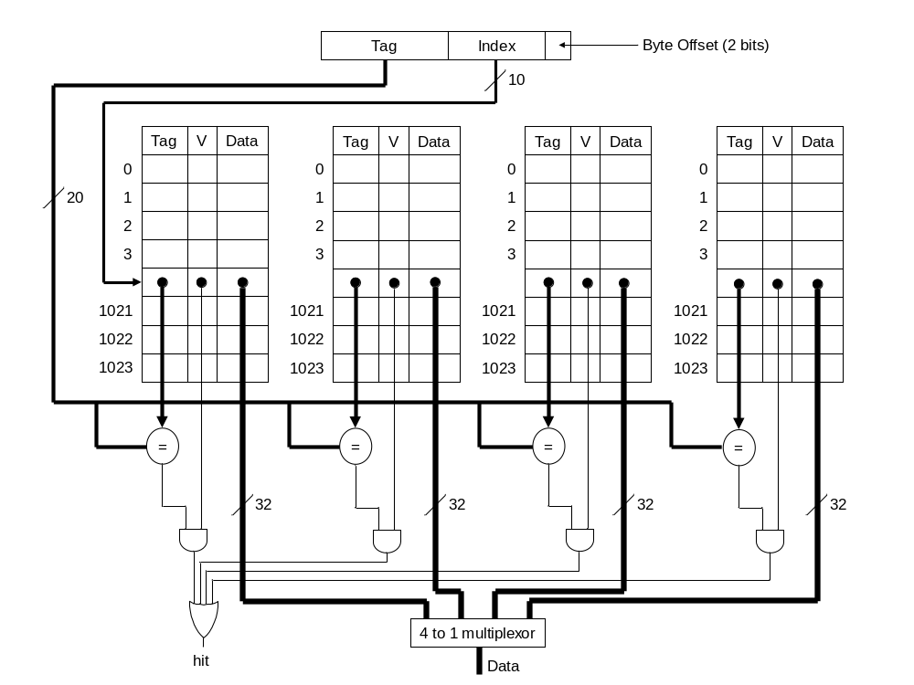

Slide 37
Example
4-way set associative cache
Cache size of 64 Kbytes.
32-bit byte-addressable memory
Each memory word contains 4 bytes
cache block size is 16 bytes.
write-through policy.
one valid bit per block.
How does the CPU interpret the memory address?
Compute the total amount of storage for implementing the cache (i.e. actual data plus the meta-data).

Slide 38
Cache replacement
C0
C1
V
Tag
data
V
Tag
data
LRU
0
1
2
3
4
5
6
7

Slide 39
C0
C1
C2
C3
V
Tag
data
V
Tag
data
V
Tag
data
V
Tag
data
LRU
0
c1 -> c3 -> c0 -> c2
1
c0 -> c2 -> c1 -> c3
2
c2 -> c3 -> c0 -> c1
3
c3 -> c2 -> c1 -> c0
LRU
Access to C1
c1 -> c3 -> c0 -> c2
Replacement candidate C2
Access to C2
c2 -> c1 -> c3 -> c0
Replacement candidate C0
Access to C2
c2 -> c1 -> c3 -> c0
Replacement candidate C0
Access to C3
c3 -> c2 -> c1 -> c0
Replacement candidate C0
Access to C0
c0 -> c3 -> c2 -> c1
Replacement candidate C1

Slide 40
Types of misses
Compulsory (cold vs. warm)
Capacity (cache is full)
Conflict (vying for same spot in the cache)
Work out Example 7 in the book on your own and check the answer

Slide 41
Path of memory access
CPU
VA
PA
Instruction or
Data
TLB
Cache
Work out Example 8 in the book on your own and
check the answer (TLB+Cache)

Slide 42
Virtually indexed physically tagged cache
How to get translation out of the critical path?
VPN
Page offset
Index
Cache
TLB
PPN
Tag
Data
=?
Hit

Slide 43
Page coloring
VPN/PFN 19 bits
Page Offset 13 bits
These 4 bits must remain unchanged through VPN to PFN translation
Tag 15 bits
Index 11 bits
Offset
6 bits
Work out Example 9 on your own and
check the solution

Slide 44
Simple memory system
CPU
Cache
Address
Data
Address (32 bits)
Data (32 bits)
Main memory

Slide 45
Memory system matching blocksize
CPU
Cache
Address
Data
Address (32 bits)
Data (128 bits)
Main memory

Slide 46
Data
(32 bits)
Memory Bank M0
(32 bits wide)
Memory Bank M1
(32 bits wide)
Block
Address
CPU
(32 bits)
Memory Bank M2
(32 bits wide)
Cache
Memory Bank M3
(32 bits wide)
Interleaved memory

Slide 47
Example
4-way interleaved memory
DRAM access time: 70 cycles.
bus cycle time: 5 cycles
Compute the block transfer time for a block size of 4 words. Assume all 4 words are first retrieved from the DRAM before the data transfer to the CPU.

Slide 48
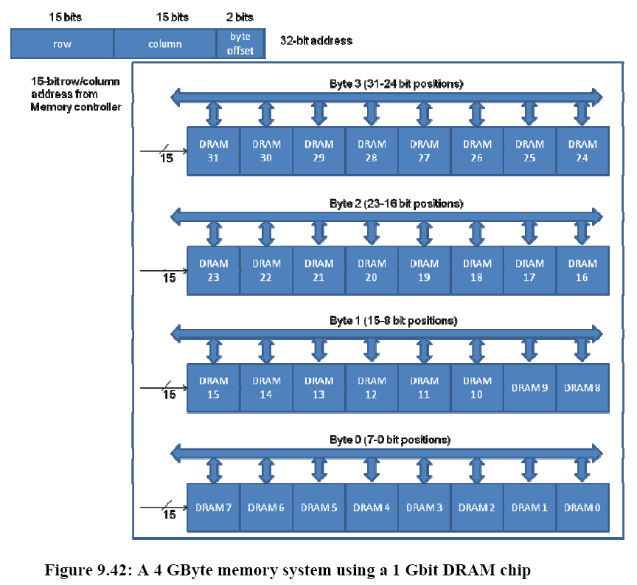
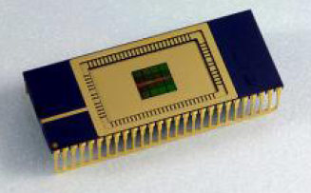

Slide 49
Type of Memory | Typical Size | Approximate latency in CPU clock cycles to read one word of 4 bytes
CPU registers | 8 to 32 | Usually immediate access (0-1 clock cycles)
L1 Cache | 32 (Kilobyte) KB to 128 KB | 3 clock cycles
L2 Cache | 128 KB to 4 Megabyte (MB) | 10 clock cycles
Main (Physical) Memory | 256 MB to 4 Gigabyte (GB) | 100 clock cycles
Virtual Memory (on disk) | 1 GB to 1 Terabyte (TB) | 1000 to 10,000 clock cycles (not accounting for the software overhead of handling page faults)
Relative sizes and latencies

Slide 50
Category | Vocabulary | Details
Principle of locality (Section 9.2) | Spatial | Access to contiguous memory locations
 | Temporal | Reuse of memory locations already accessed
Cache organization | Direct-mapped | One-to-one mapping (Section 9.6)
 | Fully associative | One-to-any mapping (Section 9.12.1)
 | Set associative | One-to-many mapping (Section 9.12.2)
Cache reading/writing (Section 9.8) | Read hit/Write hit | Memory location being accessed by the CPU is present in the cache
 | Read miss/Write miss | Memory location being accessed by the CPU is not present in the cache
Cache write policy (Section 9.8) | Write through | CPU writes to cache and memory
 | Write back | CPU only writes to cache; memory updated on replacement
Cache parameters | Total cache size (S) | Total data size of cache in bytes
 | Block Size (B) | Size of contiguous data in one data block
 | Degree of associativity (p) | Number of homes a given memory block can reside in a cache
 | Number of cache lines (L) | S/pB
 | Cache access time | Time in CPU clock cycles to check hit/miss in cache
 | Unit of CPU access | Size of data exchange between CPU and cache
 | Unit of memory transfer | Size of data exchange between cache and memory
 | Miss penalty | Time in CPU clock cycles to handle a cache miss
Memory address interpretation | Index (n) | log₂L bits, used to look up a particular cache line
 | Block offset (b) | log₂B bits, used to select a specific byte within a block
 | Tag (t) | a – (n+b) bits, where a is number of bits in memory address; used for matching with tag stored in the cache
Cache entry/cache block/cache line/set | Valid bit | Signifies data block is valid
 | Dirty bits | For write-back, signifies if the data block is more up to date than memory
 | Tag | Used for tag matching with memory address for hit/miss
 | Data | Actual data block
Performance metrics | Hit rate (h) | Percentage of CPU accesses served from the cache
 | Miss rate (m) | 1 – h
 | Avg. Memory stall | Misses-per-instruction_{Avg} * miss-penalty_{Avg}
 | Effective memory access time (EMAT_{i}) at level i | EMAT_{i} = T_{i} + m_{i} * EMAT_{i+1}
 | Effective CPI | CPI_{Avg} + Memory-stalls_{Avg}
Types of misses | Compulsory miss | Memory location accessed for the first time by CPU
 | Conflict miss | Miss incurred due to limited associativity even though the cache is not full
 | Capacity miss | Miss incurred when the cache is full
Replacement policy | FIFO | First in first out
 | LRU | Least recently used
Memory technologies | SRAM | Static RAM with each bit realized using a flip flop
 | DRAM | Dynamic RAM with each bit realized using a capacitive charge
Main memory | DRAM access time | DRAM read access time
 | DRAM cycle time | DRAM read and refresh time
 | Bus cycle time | Data transfer time between CPU and memory
 | Simulated interleaving using DRAM | Using page mode bits of DRAM

